Slide 1




Satellite-Based Lake Eutrophication Mapping
TEAM NAME: Binary Brains

Slide 2


PROBLEM STATEMENT
Water bodies across the world, particularly lakes, reservoirs, and ponds in rapidly urbanizing and agricultural regions, are facing severe degradation due to eutrophication — a process driven by excessive nutrient loading from fertilizer runoff, industrial discharge, and untreated sewage. This leads to explosive algal blooms, oxygen depletion, and the eventual collapse of aquatic ecosystems. Traditional water quality monitoring methods rely on periodic field sampling and laboratory analysis, which are time-consuming, expensive, geographically limited, and unable to capture the spatial extent of the problem across large or remote water bodies. There is a critical need for a scalable, cost-effective, and spatially comprehensive approach to monitor and map eutrophication levels continuously.

Slide 3


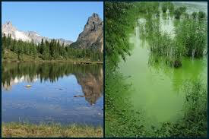

Our Solution
We propose a satellite-based eutrophication mapping system that leverages freely available multispectral imagery from the Sentinel-2 satellite to assess and classify water quality across large water bodies without any physical field intervention. By applying established remote sensing indices such as the Normalized Difference Water Index (NDWI) for water extraction, the Normalized Difference Chlorophyll Index (NDCI) for estimating algal concentration, and the Trophic State Index (TSI) for standardized eutrophication classification, our system generates color-coded thematic maps that categorize water bodies into oligotrophic, mesotrophic, and eutrophic zones. This provides environmental agencies, researchers, and policymakers with a reliable, repeatable, and visually interpretable tool for water body health monitoring at scale.

Slide 4


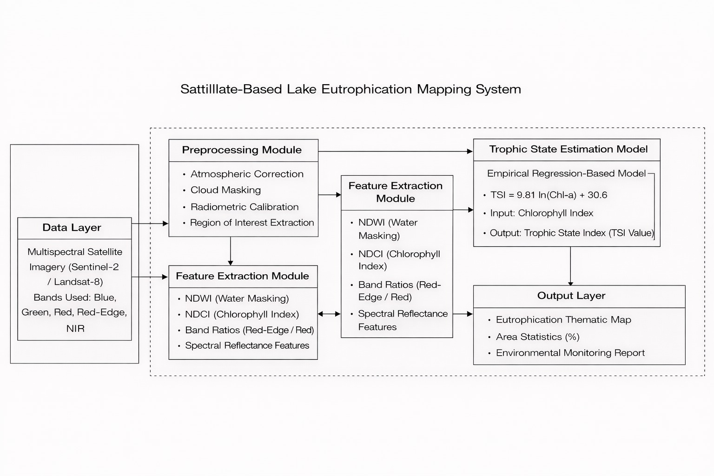
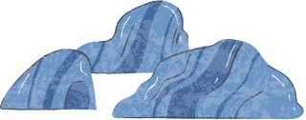
ARCHITECTURE

Slide 5
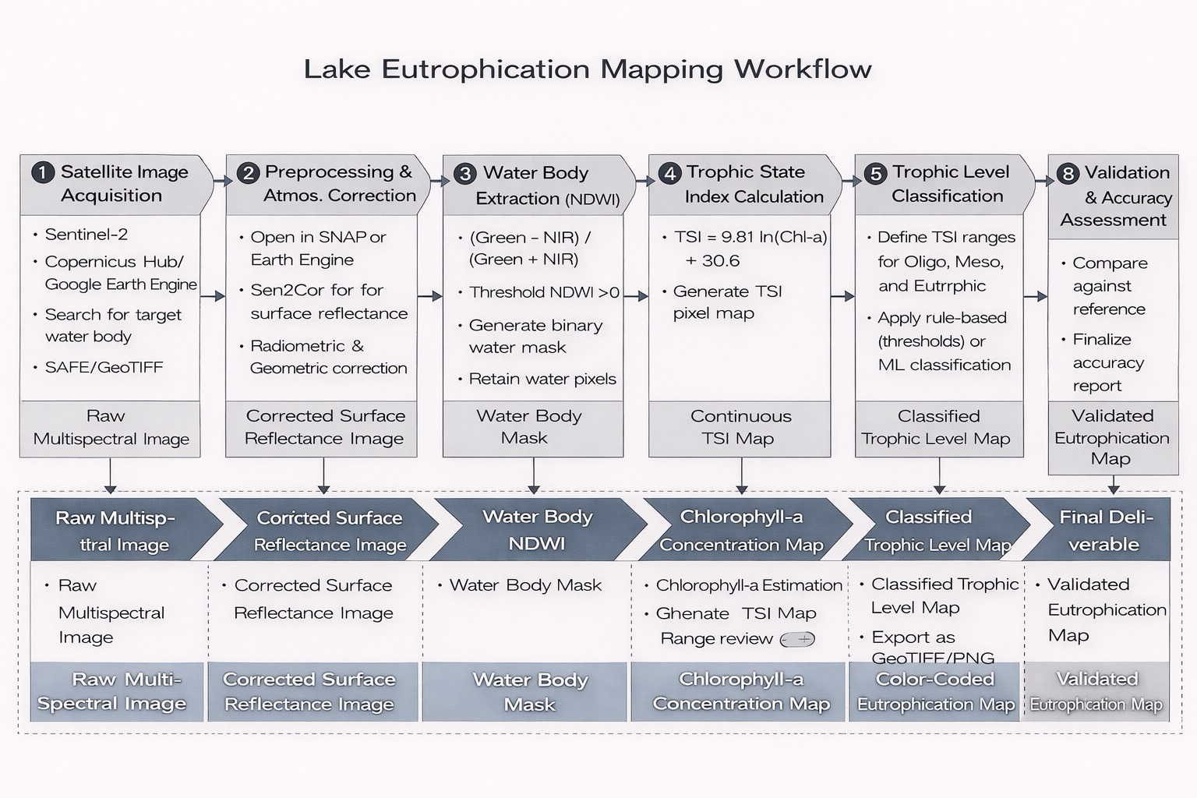
Work Flow

Slide 6
STEP 1 — Satellite Image Acquisition :
Select Sentinel-2 as the primary satellite source (free, high resolution, multispectral)
Access data from Copernicus Open Access Hub or Google Earth Engine
Search for the target water body (lake/reservoir) by coordinates or region
Filter images with less than 10% cloud cover
Select images from the same season for consistent multi-year comparison
Download in .SAFE format or export as GeoTIFF
Output: Raw Multispectral Satellite Image

Slide 7
STEP 2 — Preprocessing & Atmospheric Correction :
Open the raw image in SNAP Software or Google Earth Engine
Apply Sen2Cor plugin to perform atmospheric correction
Convert Top-of-Atmosphere (TOA) reflectance to Bottom-of-Atmosphere (BOA) surface reflectance
Remove distortions caused by aerosols, water vapor, and haze
Apply radiometric calibration to normalize pixel values
Apply geometric correction to align image with real-world coordinates
Clip the image to the study area boundary (Region of Interest)
Output: Corrected Surface Reflectance Image
STEP 3 — Water Body Extraction using NDWI :
Select the Green band (B3) and Near-Infrared band (B8) from the image
Apply the NDWI formula: NDWI = (Green − NIR) / (Green + NIR)
Set threshold: pixels with NDWI > 0 are classified as water
Generate a binary water mask (Water = 1, Land = 0)
Apply the mask to filter out all non-water land pixels
Retain only water pixels for further analysis
Output: Water Body Mask (Binary Raster)

Slide 8
STEP 4 — Chlorophyll-a Estimation using NDCI
Select the Red Edge band (B5) and Red band (B4) from the masked image
Apply the NDCI formula: NDCI = (RedEdge − Red) / (RedEdge + Red)
Apply NDCI only to the water pixels identified in Step 3
Higher NDCI value indicates higher algal concentration
Convert NDCI values to Chlorophyll-a concentration (µg/L) using calibration equations
Generate a spatial map of Chlorophyll-a concentration across the water body
Output: Chlorophyll-a Concentration Map
STEP 5 — Trophic State Index (TSI) Calculation
Take the Chlorophyll-a concentration values from Step 4
Apply the TSI formula for each water pixel: TSI = 9.81 × ln(Chl-a) + 30.6
Calculate TSI for every individual water pixel across the entire water body
Generate a continuous TSI raster map showing nutrient intensity spatially
Review the TSI value range to understand the overall health of the water body
Output: Continuous TSI Pixel Map

Slide 9
STEP 6 — Trophic Level Classification
Define classification thresholds based on standard TSI ranges
Assign Class 1 — Oligotrophic → TSI below 40 (low nutrients, clean water)
Assign Class 2 — Mesotrophic → TSI between 40 and 50 (moderate nutrients)
Assign Class 3 — Eutrophic → TSI above 50 (high nutrients, algal bloom risk)
Apply classification using one of two methods:
Method A: Rule-based thresholding (simple if-else logic in Python or GEE)
Method B: Machine Learning using Random Forest or SVM with features like NDCI, NDWI, and band reflectance
Generate a classified raster with 3 distinct trophic classes
Output: Classified Trophic Level Map (3 Classes)

Slide 10
STEP 7 — Thematic Map Generation
Assign distinct colors to each trophic class for visual clarity
Blue → Oligotrophic
Yellow → Mesotrophic
Red → Eutrophic
Add map elements: title, legend, north arrow, scale bar
Use Python (Rasterio + Matplotlib) or QGIS for map rendering
Overlay the classified map on a base map for geographic context
Export the final map as GeoTIFF (for GIS use) or PNG/PDF (for reporting)
Output: Color-Coded Eutrophication Thematic Map
STEP 8 — Validation & Accuracy Assessment
Collect reference data — government water quality reports, CPCB datasets, or field sampling records
Select a set of ground truth points with known trophic class
Compare classified map output against ground truth at those points
Build a Confusion Matrix showing correct vs incorrect classifications per class
Calculate Overall Accuracy = (Correctly classified pixels / Total pixels) × 100
Calculate Kappa Coefficient to measure agreement beyond chance
If accuracy is below 85%, revisit classification thresholds or retrain the ML model
Document all accuracy metrics in the final project report
Output: Validated Eutrophication Map + Accuracy Report

Slide 11
Conclusion
Through eutrophication, the water bodies are silently degrading and sometimes it may be detected when the process has taken place and the result is catastrophic. The present project has shown that the constant and extensive monitoring of lake health can be achieved through the free access of Sentinel-2 satellite data along with the preexisting indices like NDWI, NDCI, and Trophic State Index.
The system will enable a scalable, cost-effective, spatially exhaustive system of determining the level of eutrophication by removing reliance on field sampling, which is time-intensive. It allows catching and visualizing these early and making informed decisions to support communities, farmers, and policymakers that depend on the presence of freshwater.
Although issues such as cloud cover and environmental variability still exist, the work itself is a considerable step of proactive and technological-based environmental monitoring, which adds to the problem of sustainable management of freshwater ecosystems.

Slide 12
TEAM MEMBERS
Ponjeyakumar R -22MIS1035
Joshika B R -22MIS1147
Hema swethaa V T - 22MIS1133
Samaseni Bindusri - 22MIS1061
Loukhya Y - 22MIS1041

Slide 13
Thank You!
!uoY knahT

